Slide 1
SEND at Chenderit
Monday 14th September 2026
Welcome to SEND at
Chenderit

Slide 2
Houskeeping
Should the fire alarm sound we will exit via the doors at the rear of the lecture theatre and make our way to the tennis courts
Please switch phones to silent
Please complete the paper slip you’ve been given and pass to a member of staff at the end of the session.

Slide 3

Welcome!
Thank you for joining us today. You have been invited because you have a child in Year 7 or Year 12 (new to Chenderit) who is on our SEND register or has an EHCP

Slide 4
AIMS OF OUR EVENT
In the session, we aim to:
* Introduce our SEND and Inclusion teams
* Outline the support for SEND/inclusion students within Chenderit
* Share with you how we support students with their exams
* Explain how we communication with families
* Explain how we aim to work alongside families through Assess, Plan, Do, Review meetings.

Slide 5
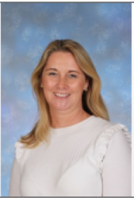
INTRODUCE OUR SEND AND INCLUSION TEAMS
I have worked at Chenderit for 13 years, starting my journey as a Teaching Assistant, working across almost every department as a Cover Supervisor, and going on to gain my Qualified Teacher Status (QTS) as well as my National Professional Qualification for SEND. Over the last three years, I had the privilege of serving as Deputy SENCO, which allowed me to build strong relationships with our students and families while gaining a deep, working knowledge of how our SEN department runs. I continue to teach Health & Social Care and Early Childhood Development in KS4 and KS5 alongside my role as SENDCo.
Anna Greening SENDCo agreening@chenderit.net

Slide 6
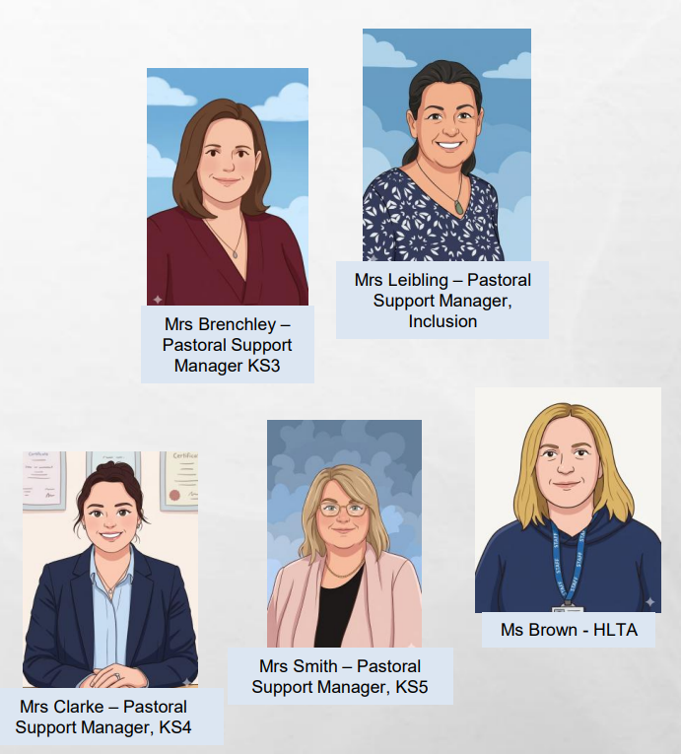

SEND TEAM
We have an experienced and dedicated team of 9 Teaching Assistants who support in lessons throughout the school, each with subject specialisms.

Slide 7
Joining us today
Mrs Kerry TA
Mrs Webb TA
Mrs Williams TA
Mrs Armstrong HLTA
Mrs Brenchley KS3 Pastoral Support Manager (PSM)

Slide 8
INCLUSION TEAM
Mrs J Hooper - Safeguarding, Student Welfare and Parent Support Manager and Deputy Designated Safeguarding Lead
Mrs A Smith - Deputy Safeguarding, Student Welfare and Parent Support Manager and Deputy Designated Safeguarding Lead
Mrs Brenchley – KS3 pastoral manager located in the PSM office at the end of the humanities corridor.
Mrs Leibling- SEND pastoral manager (supporting re-engagement with school)
Mrs Clarke- KS4 pastoral mananger
Mrs Caske and Mrs Andrews - Attendance
Ms Liston – Medical
Mrs Guynan – SEND Administrator
Mrs Waite – SEND Administrator

Slide 9
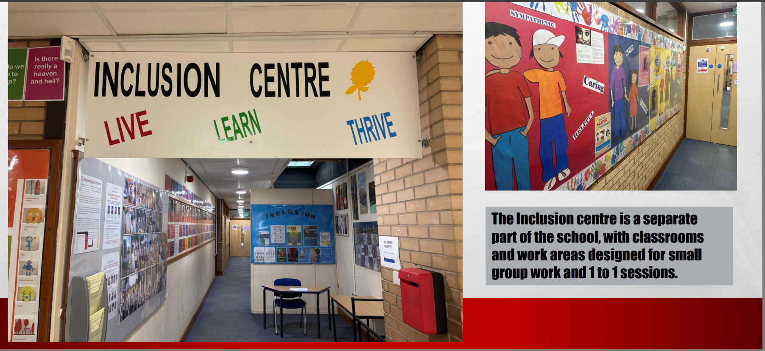
Our Inclusion Centre

Slide 10
VISION OF THE SEND DEPARTMENT
At Chenderit School, we believe that every child has the right to a broad, balanced, and inclusive education. We are committed to high quality ordinarily available provision and adaptive teaching that remove barriers to learning, ensuring every pupil can thrive.
Additionally, we ensure that any required interventions and support are put in place where needed. Interventions are devised with the advice of key professionals. We strive to ensure that all students achieve their potential from whatever their starting point personally, socially, emotionally and academically in all areas of the curriculum.
.

Slide 11
SUPPORT FOR SEND/INCLUSION STUDENTS WITHIN CHENDERIT
Quality first teaching through our ordinarily available provision
Small group withdrawal time
Individual class support/individual withdrawal
Bilingual support- adapted resources and additional support

Slide 12
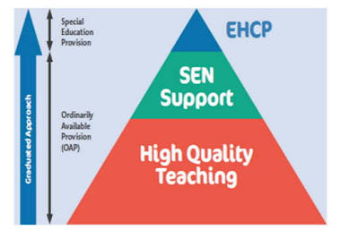
What is ordinarily available provision (OAP) and the graduated approach?
Ordinarily Available Provision (OAP) is the foundation of high-quality, inclusive education. It refers to the standard strategies, resources, and classroom adaptations that mainstream schools provide for all pupils

Slide 13
What ordinarily available provision (OAP) can look like in the classroom.
Adaptive Teaching: Modifying/adapting instructions, tasks, or pace so every student can access the same high-standard curriculum.
Visual & Structural Supports:, task checklists, writing frames, WAGOLLs, and key vocabulary banks displayed in the classroom or exercise books.
Learning Environment Adjustments: Sensory-friendly seating arrangements, quiet working spaces, and access to movement breaks when needed.
Practical Resources: Access to supportive equipment such as coloured overlays/paper, enlarged font, knowledge organisers, use of a laptop, reading pens and tactile focus tools.
Clear Communication: Breaking instructions down into manageable, step-by-step chunks and giving extra time for processing information, regular check-in with class teacher or TA.

Slide 14
How OAP Fits into the Graduated Response
High Quality Teaching: OAP starts in the mainstream classroom. Most learning needs are successfully met through these standard adaptations.
SEND support: If a child needs further support despite OAP strategies, teachers monitor their progress and adjust interventions and adaptations accordingly. At Chenderit we involve parents/carers in the Assess, Plan, Do, Review process
Targeted Support: If progress remains a concern, the school SENCo collaborates with parents and specialists to put more targeted, individual interventions in place.

Slide 15
Understanding the SEND Register vs. SEND Monitoring List
Being on the SEND Register means your child receives support that is additional to or different from what is routinely provided to all students in the classroom.
As children transition from primary to secondary school, their needs often change. Moving between classrooms, having different teachers, and taking natural breaks throughout the day can mean that some support required in primary school is no longer needed.
SEND Register
Who it is for: Students receiving specialised, targeted support beyond standard classroom adaptations and ordinarily available provision.
What it means: Individual interventions or specific extra provisions are actively in place.
SEND Monitoring List
Who it is for: Students whose needs are effectively met through our standard inclusive teaching (Ordinarily Available Provision).
What it means: We closely track their progress and well-being, but they do not require extra, distinct interventions at this time.

Slide 16
Understanding the SEND Register vs. SEND Monitoring List
Flexibility: Movement between the SEND Register and the Monitoring List is flexible and fluid as we get to know your child and see what works best for them.
No Loss of Access: Being on the Monitoring List does not stop a child from receiving support if needed later, nor does it affect testing for Exam Access Arrangements.
Goal: We aim to ensure every student sits in the exact tier of support that matches their current daily needs.

Slide 17
Assess, Plan, Do, Review (APDR)
At secondary school, managing individual learning plans/passports for every student across 10 to 12 different subject teachers isn't practical. Instead, we use the Assess, Plan, Do, Discuss, Review (APDR) cycle.
This is a continuous process that ensures your child gets consistent, practical support in every classroom.
1. Assess: School checks classroom progress and reading levels; you share how your child learns and copes at home.
2. Plan: School designs practical classroom adaptations; you help set realistic targets and suggest what works at home.
3. Do: Teachers put agreed strategies into practice across all subjects; you encourage supportive routines at home.
4. Discuss & Review: We meet to review progress, celebrate your child success and adjust support as needed.
•Action First: Focuses on real support in the classroom rather than filling out forms.
•Joined-Up Approach: Ensures all subject teachers use the same effective strategies.
•True Partnership: Keeps you fully involved in every decision about your child's education

Slide 18
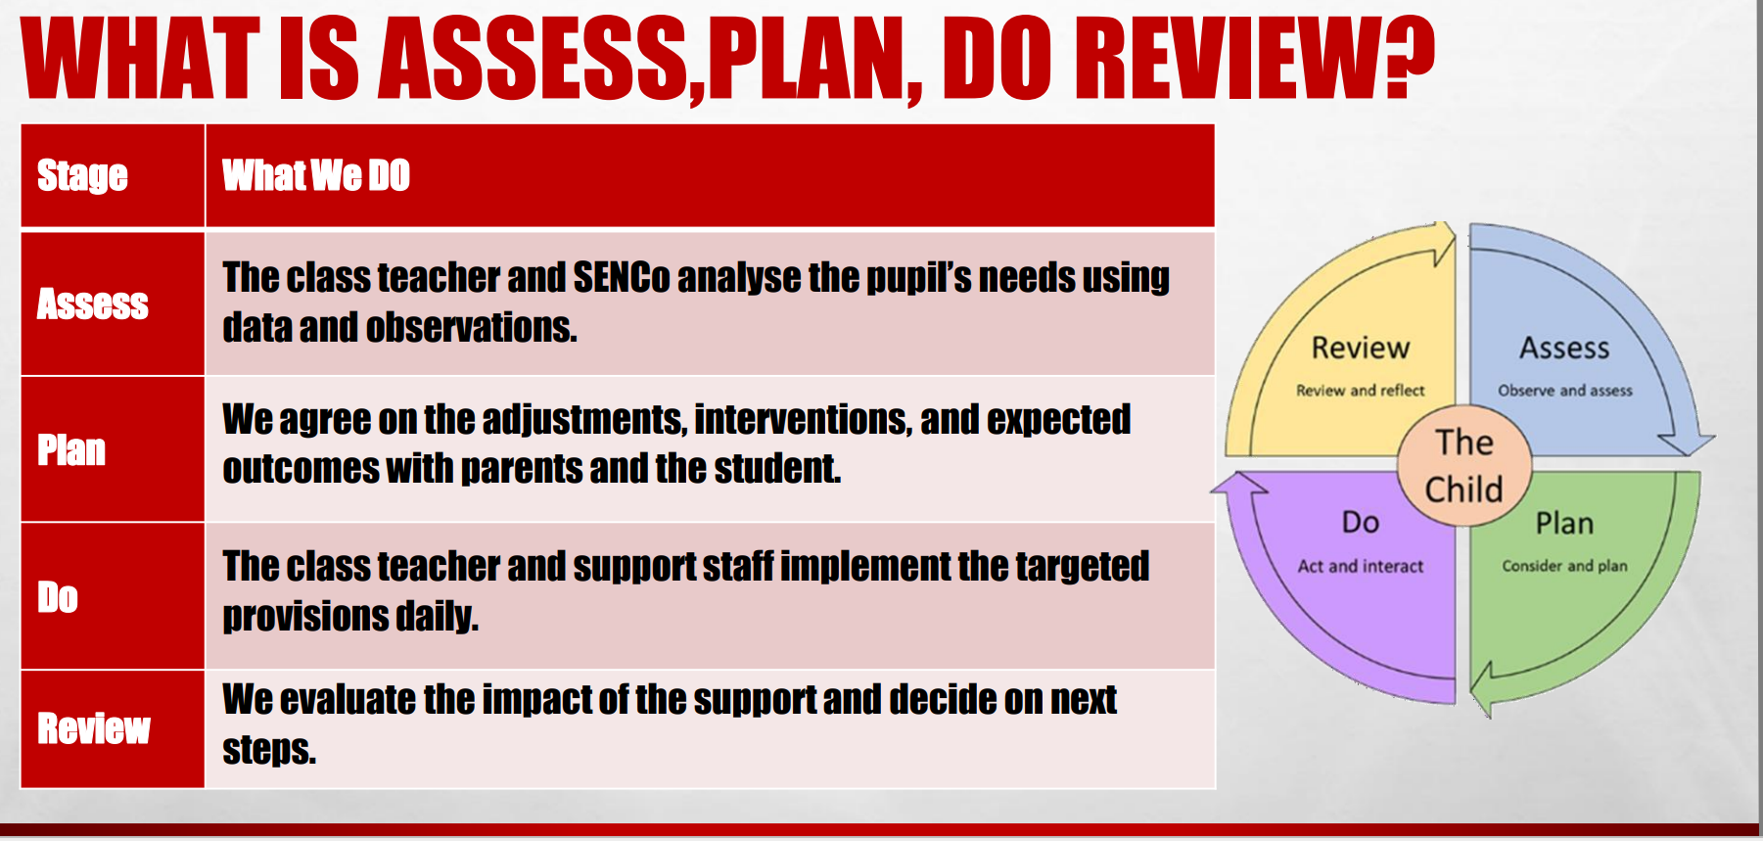

Slide 19
DATES OF 1st APDR MEETINGS
The first APDR is prominently so we can meet you and understand how the transition to Chenderit has been.
Y7- Thursday 17th September
Y12- at parents’ evening or by separate appointment
Meetings can either be face to face, via the telephone or email communication.
We encourage that the young person attends too but for the first meeting in year 7 we understand that they may not wish to attend.

Slide 20
HOW WE WILL COMMUNICATE WITH FAMILIES
For SEND related matters please contact :
Miss Greening agreening@chenderit.net
At Chenderit, we expect staff to respond to emails within 3 working days
For any pastoral matters, in the first instance please contact your child’s form tutor.
There will be a SEND piece/information from Inclusion in our KIT newsletter
Assess, Plan, Do, Review (APDR) meetings

Slide 21
How we support students with their exams
Exam Access Arrangements (EAA)
Exam Access Arrangements are designed to ensure all students can demonstrate their knowledge without being disadvantaged by learning or medical needs.
No Formal Diagnosis Required: A child does not need an official diagnosis to be assessed for exam access arrangements.
Open to All Support Levels: Students on either the SEND Register or the SEND Monitoring List will be assessed if we identify a clear need.
Formal Testing Timeline: Official testing takes place in the Summer Term of Year 9. JCQ regulations state that formal arrangements are time-bound; testing any earlier would mean the approval expires before students sit their final GCSEs.
Evidence-Based: Formal arrangements must reflect a student's "normal way of working" in class. Approvals are based on teacher observations, assessment data from progress exams (PPEs), specialist reports, and standardied testing showing "substantial impairment.“
Types of Access Arrangements Available
Extra time (e.g., 25%)
Use of a laptop/computer
Reader or computer reader
Prompter
Rest breaks

Slide 22
Internal & End-of-Year Exams (Years 7–9)
For school-based internal exams, we make every effort to replicate the arrangements and support students may have received in primary school. However:
Resource & Space Constraints: Providing individual 1:1 scribes, separate seating, or small exam rooms for internal assessments is extremely difficult due to staffing and rooming limitations—especially as formal GCSE examinations are often running at the same time.
Best Endeavours & Adaptations: While we use our best endeavours to accommodate needs, teachers will primarily make practical adaptations within the subject exam papers and standard classroom settings to ensure every student is supported.

Slide 23
SEND in 6th Form
We aim to offer a supportive and inclusive Sixth Form to our students with SEND
Subject staff work hard to support all students in lessons, adapting lessons where appropriate to suit the needs of the students.
Students who had specific access arrangements at GCSE will continue to access this support when sitting Pre Public Exams and final, external exams.

Slide 24
6th Form
We are also incredibly fortunate to have a dedicated study supervisor/pastoral- Mrs Smith. Mrs Smith works closely with all of our students to ensure they are developing the independent study skills that are required to secure success in their examinations, whilst also providing care, guidance and support to students who may need it.
Mrs Smith may offer students on a 1 - 1 basis where necessary, offering support with class work, homework and revision skills.

Slide 25
6th Form
Students are able to use laptops to use in lesson time and in non-contact time to support them. Many subjects make lessons resources available to students in advance to support students in class. Worksheets, power points and revision resources can be printed off in advance of lessons to support students with their learning
Students in the Sixth Form work closely with subject staff, form tutors and the Sixth Form Leadership team to ensure they are supported in making good progress across their subjects at A level

Slide 26
Interventions in school
The majority of interventions for year 7 will not begin until after October half term.
Lego therapy
Social skills group
Touch typing
Morning readers
RWI sessions
1:1 check ins
Empowerment foundation

Slide 27

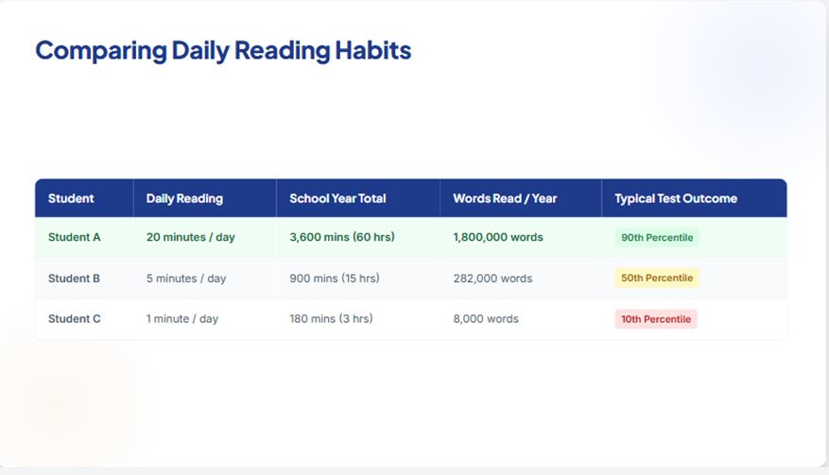
Significance of reading

Slide 28
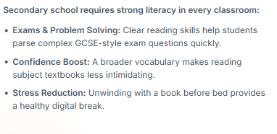
Reading supports in unlocking success across all subjects
How You Can Help at Home
Reading doesn't always have to be a traditional novel. Audiobooks, graphic novels, non-fiction books, comics, recipe books and interest-based magazines all count! Encouraging your child to unwind with a book for 20 minutes before bed or after dinner is one of the most powerful ways to support their education

Slide 29
How will we help in school?
ART comprehension test (all Y7 students)
Reading age data shared with staff
RWI phonics (8 students in Y7)
Learning Resource Centre (LRC) induction lesson
Morning reading in tutor time
Access to reading pens (KS4-5)
A range of dyslexia friendly reading books
Each year 7 and 8 students has been given a copy of the book they are reading in tutor time
Stop drop and read
16 before 16
Year 7 read at the start of each English lesson

Slide 30
After school restraint collapse
"After-school restraint collapse" happens when a child—especially neurodivergent children —spends all day masking, keeping their emotions in check, and following school expectations, only to completely dysregulate once they reach they home.
Skip Questions: Say "Lovely to see you"—don't ask about their day straight away.
Feed Fast: Make sure snacks and drinks immediately to head off low blood sugar, which will aid dysregulation.
Zero Demands: Give them 30–60 minutes of quiet, unstructured downtime.
Sensory Reset: Offer headphones, a weighted blanket, or a quiet room, listen to music
Delay Homework: Leave prep and schoolwork until later in the evening or early tomorrow morning.
Use Visuals: Swap spoken instructions for simple visual checklists.
Co-Regulate: Treat dysregulation as nervous system overload, not bad behaviour.

Slide 31


After school restraint collapse

Slide 32
Signposting to external support- SEMH
https://www.chenderit.northants.sch.uk/Our-School/Safeguarding-and-Wellbeing/

Slide 33

West Northants Local Offer
https://www.westnorthants.gov.uk/local-offer
Post support for parent/carer events
Webinars

Slide 34

THANK YOU FOR ATTENDING
We are looking forward to getting to know your child and working with you supporting them through their journey at Chenderit.
Please pass your paper slip to a member of staff
https://www.chenderit.northants.sch.uk/Our-School/SEND/

